Slide 1
Καιρος
Noah Gallo, Nathaniel Kanooi, Tre Carlton, Isaiah Houge, Colby Nelson

Slide 2
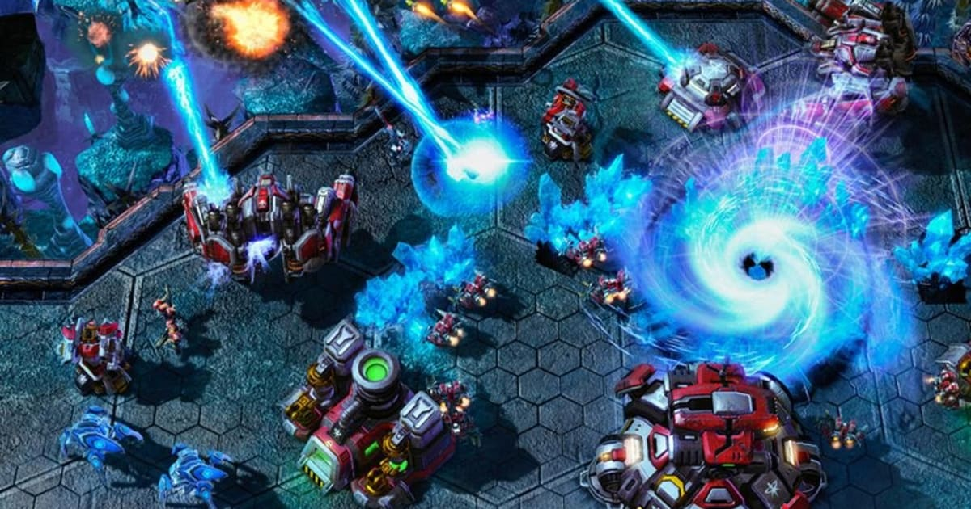
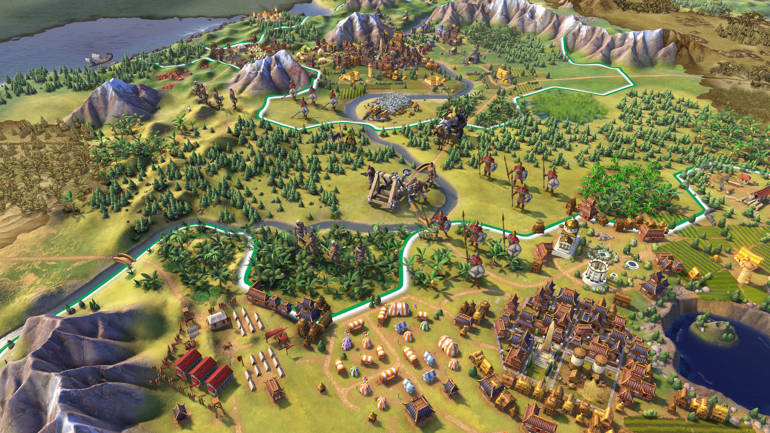
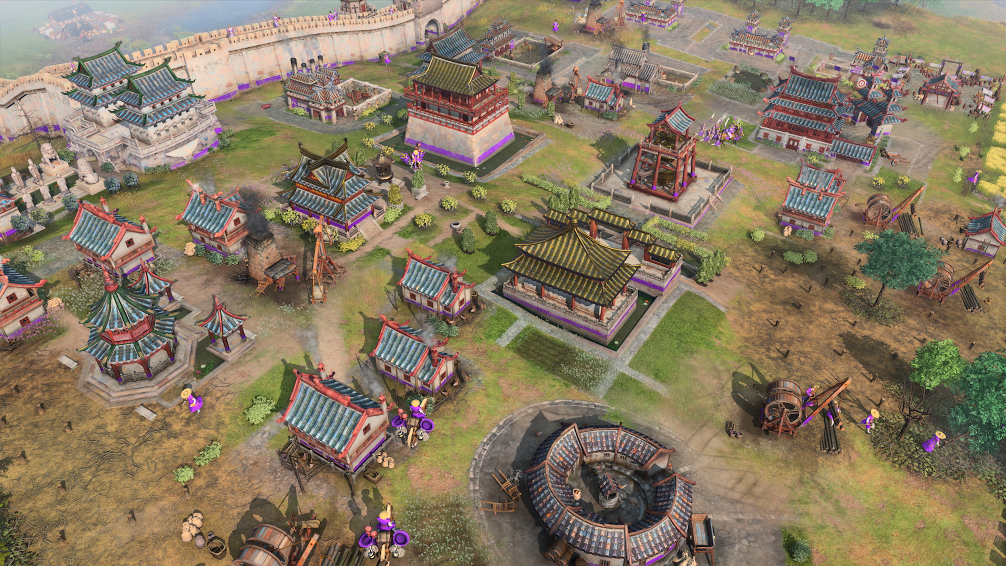
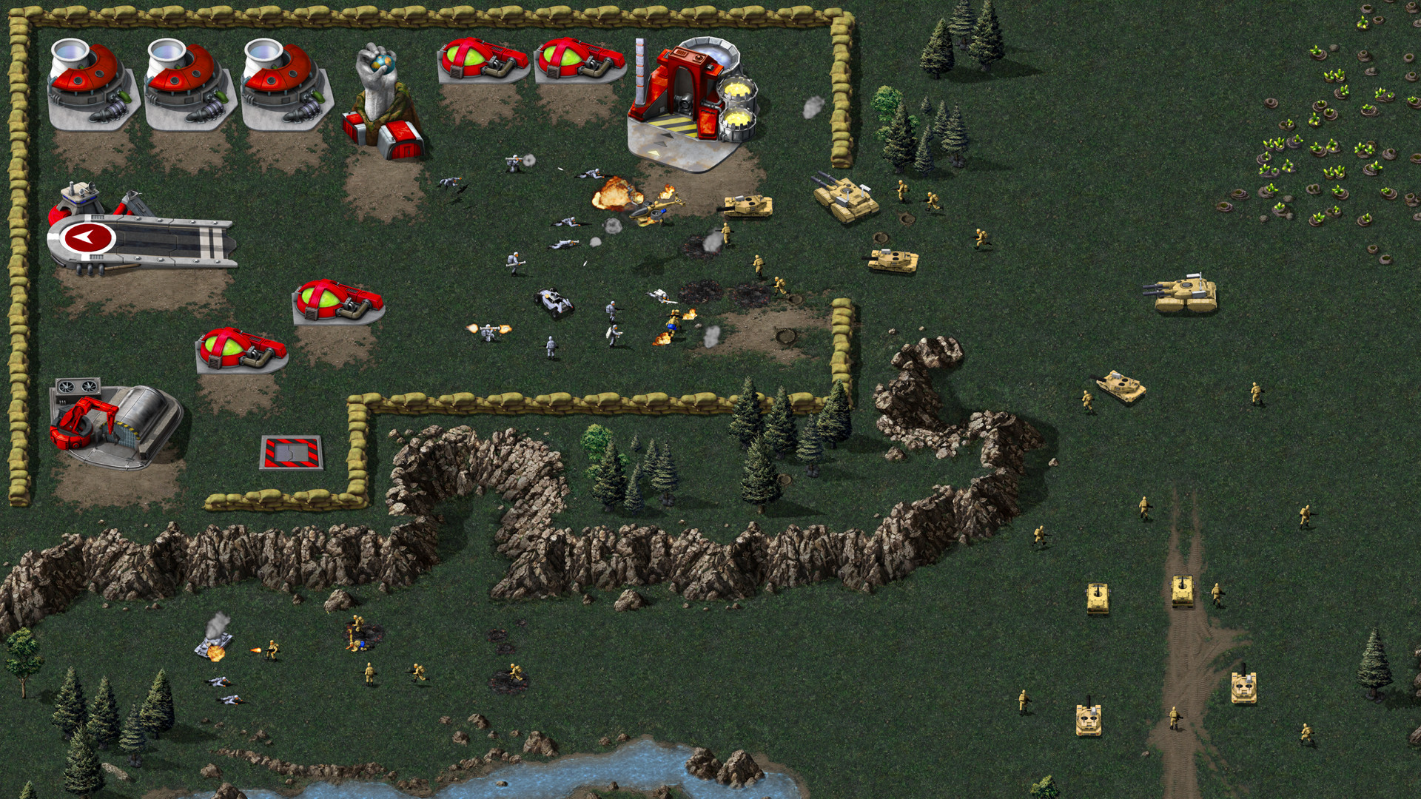
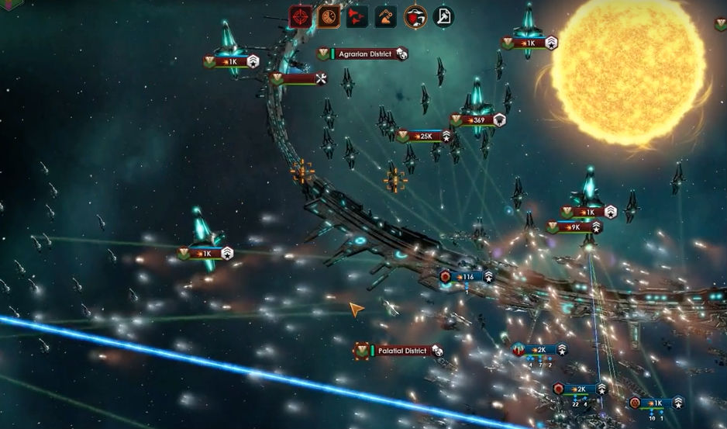
What is Καιρος?
Empire Builders
Real Time Strategy

Slide 3

Audience

Slide 4




Tools

Slide 5

Deployment

Slide 6
Goals

Slide 7
User Stories
Every time the begins a new journey, there will be a randomly generated map that makes gameplay varied and unique
“The world does not revolve around the player”
The player will be able train hero's and leaders to run their nation and armies when the player is preoccupied
Players will be able to choose their path of diplomacy or war to becoming the largest nation

Slide 8
Technical Goals

Slide 9
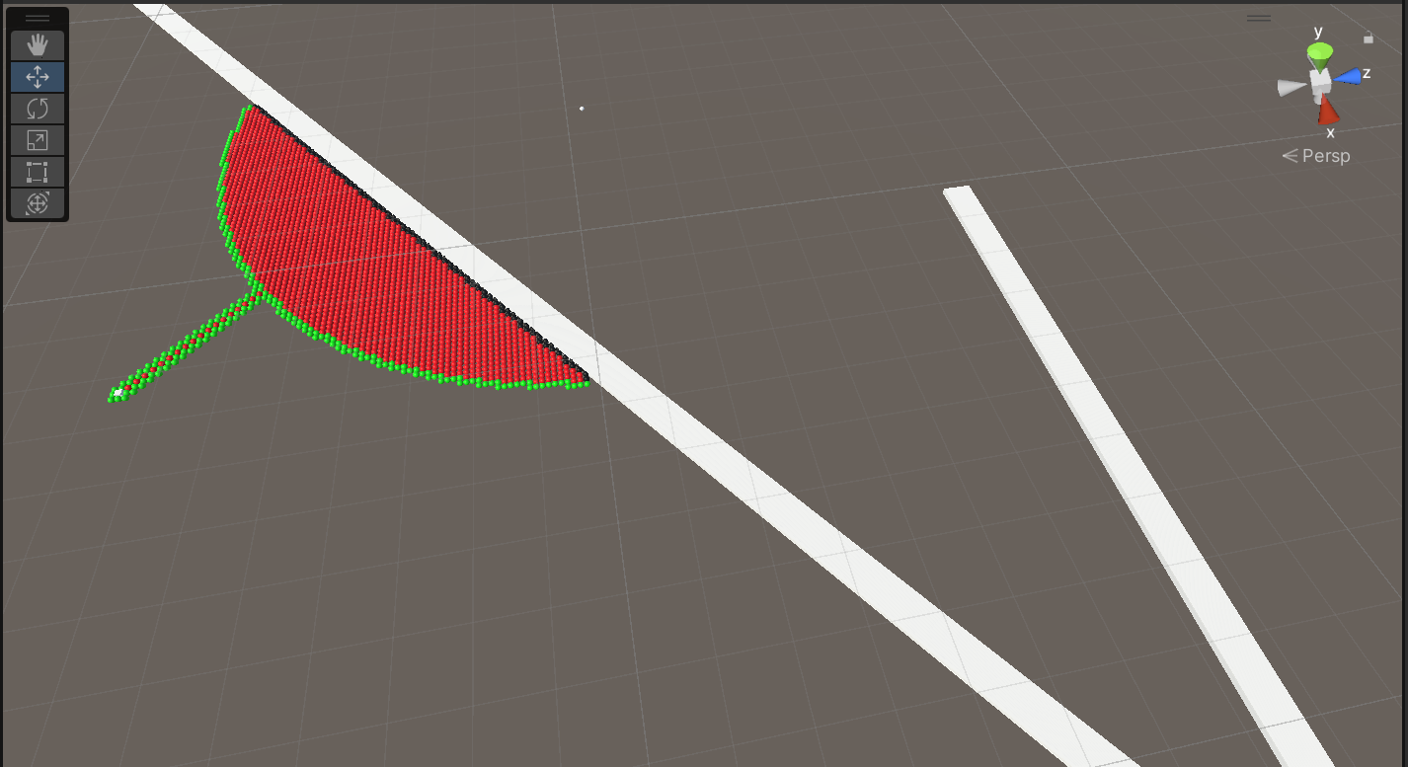
Pathfinding

Slide 10
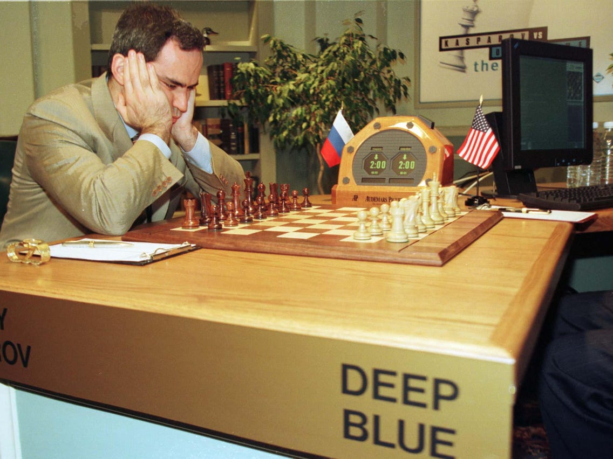
CPU Opponent

Slide 11

Map Generation

